Slide 1


BrisPUG

Slide 2
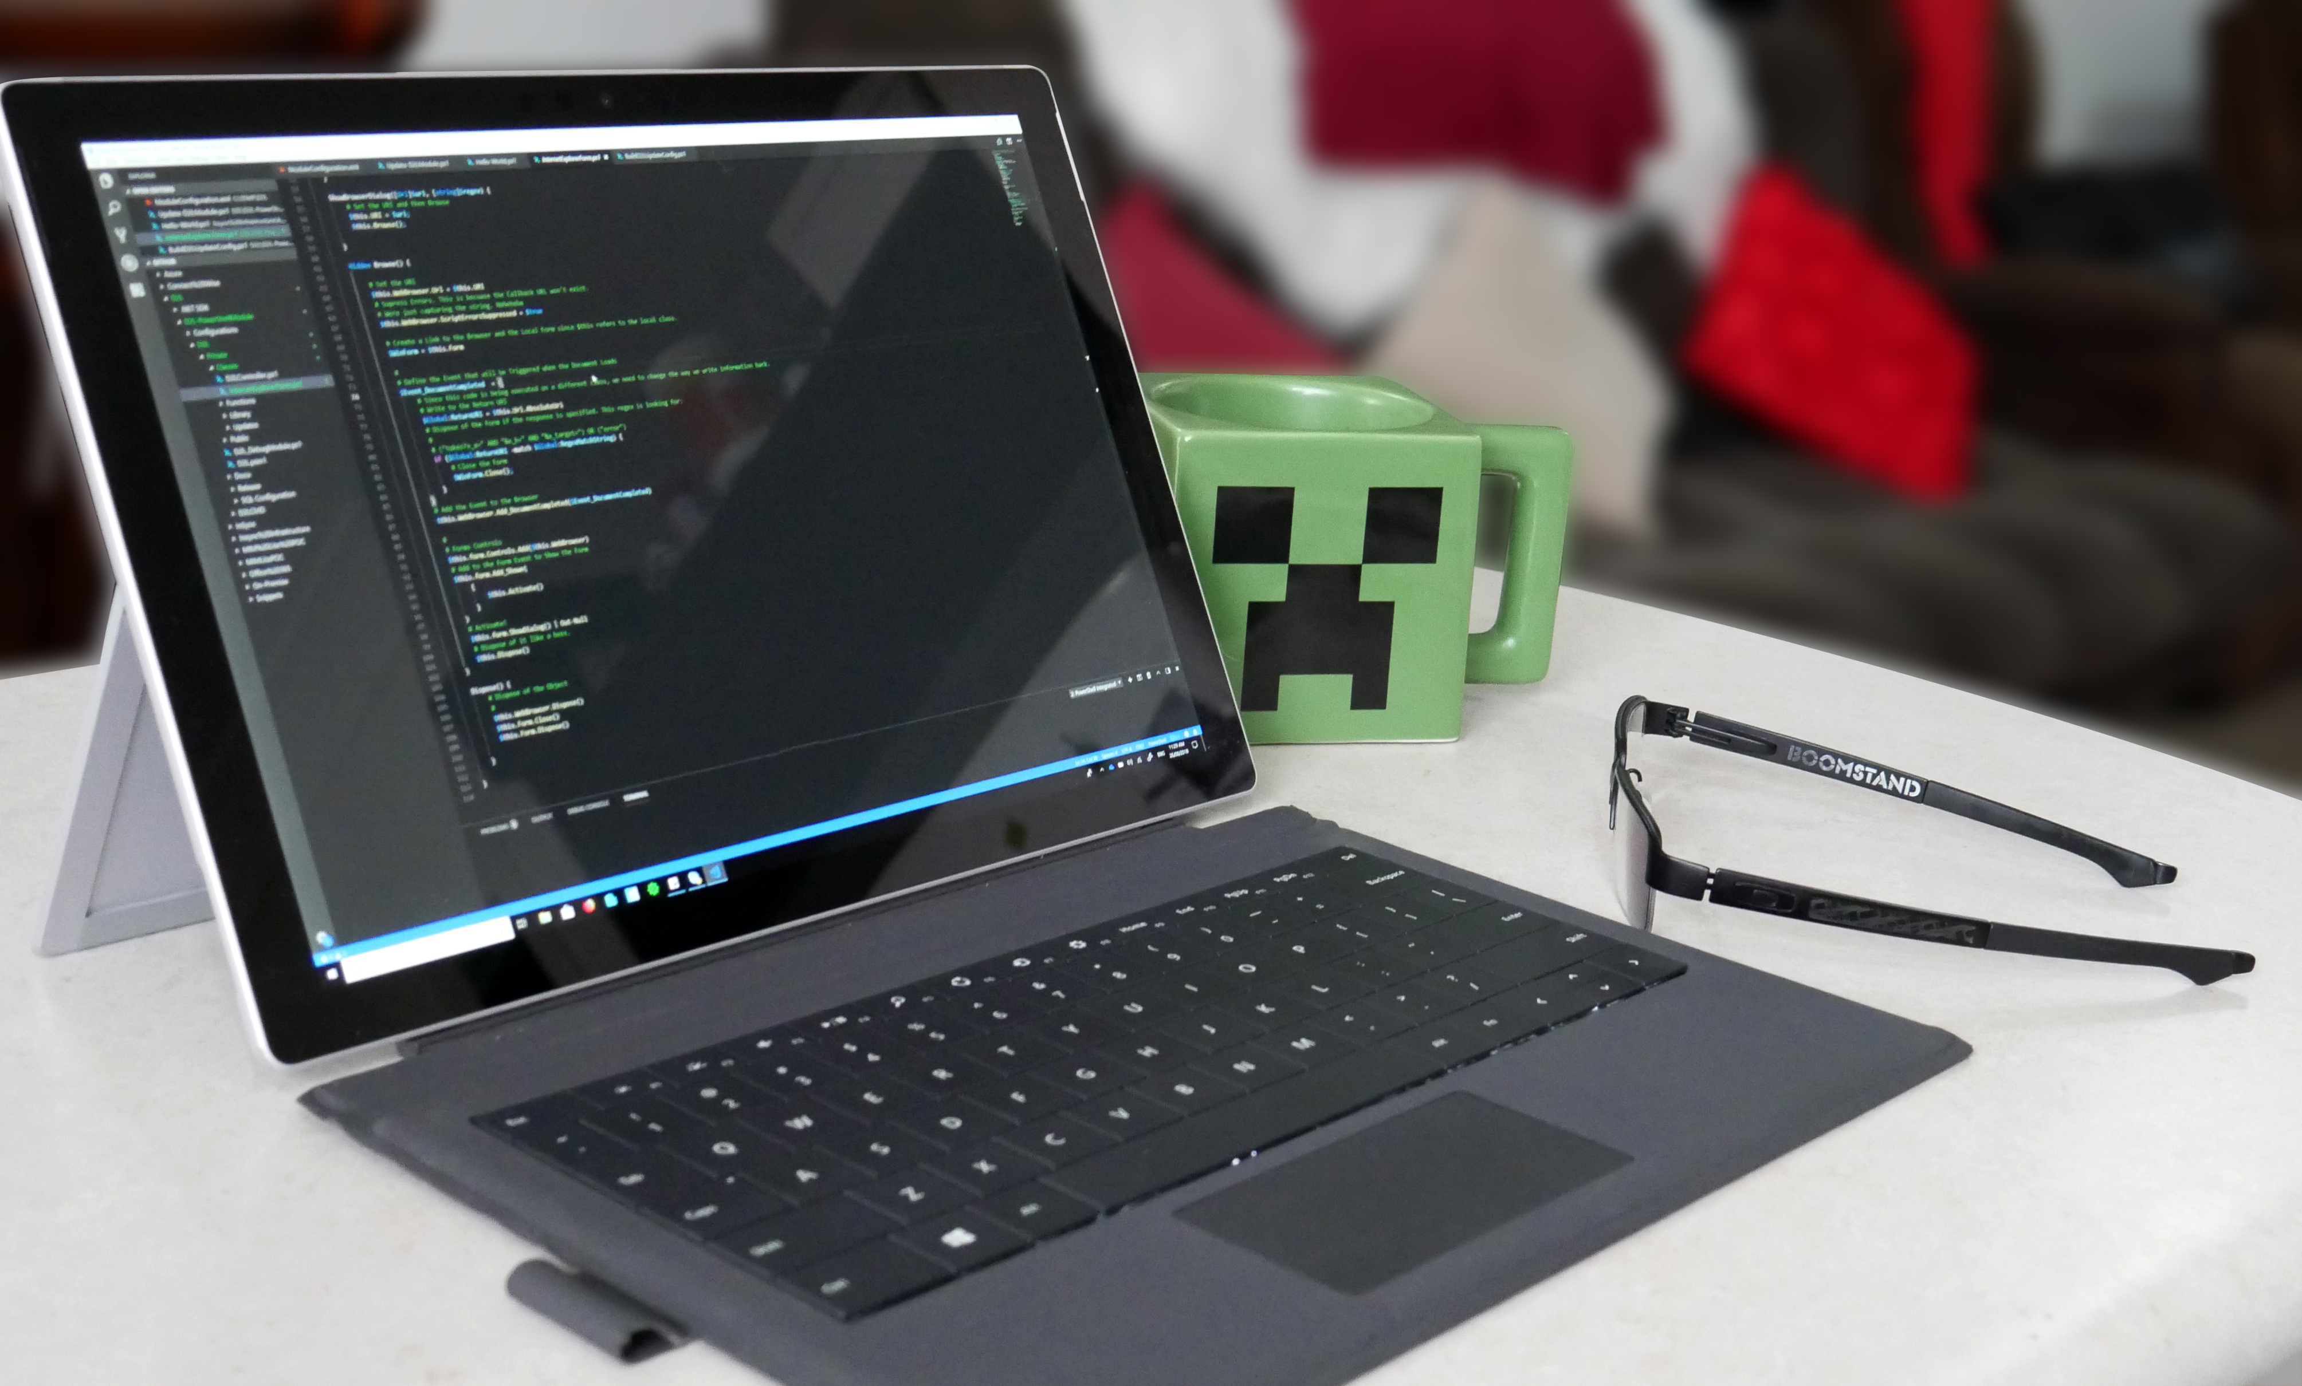


Sponsored by

Slide 3

PowerShell News

Slide 4
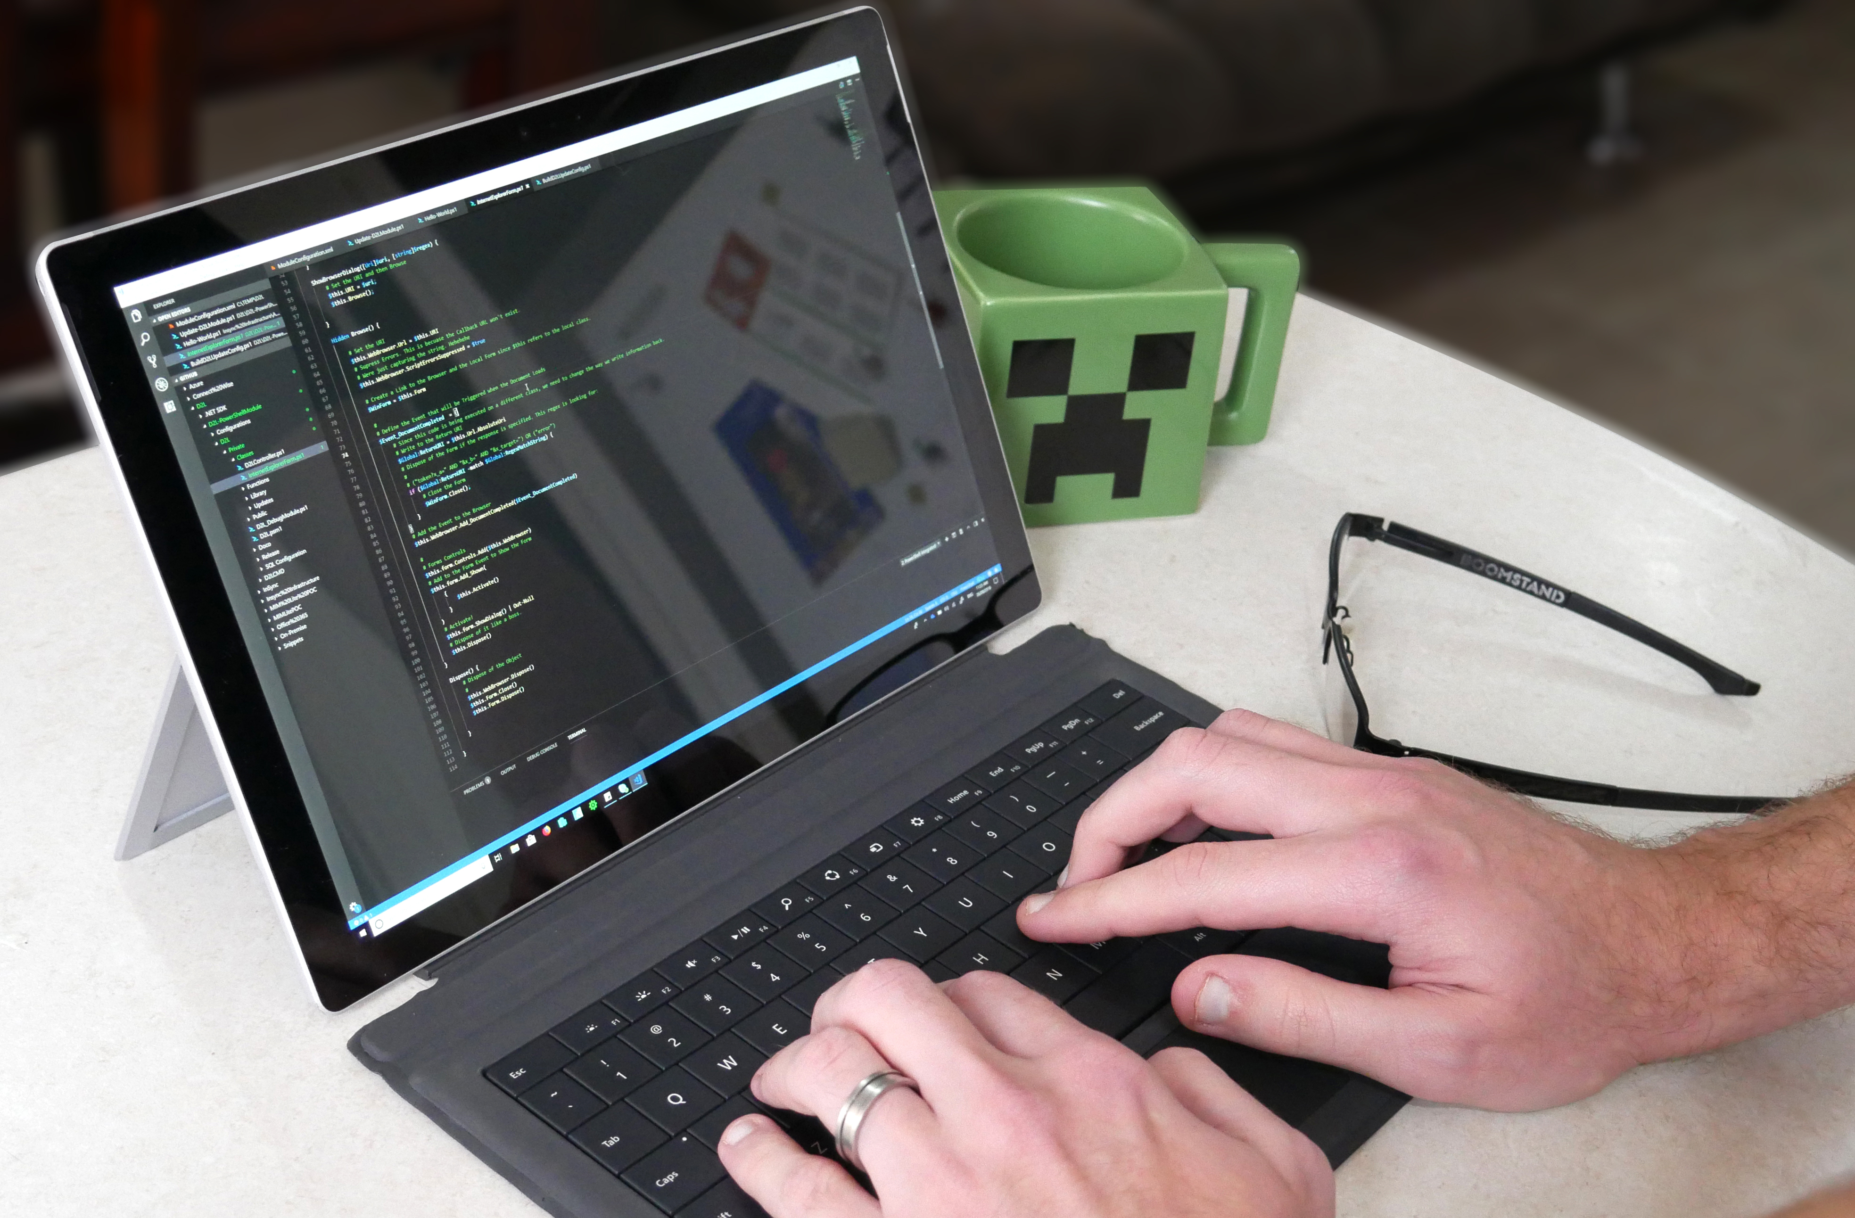

PowerShell Core 6.1
Compatibility with 1900+ existing cmdlets in Windows 10 and Windows Server 2019
Built on top of .NET Core 2.1
Support for the latest versions of Windows, macOS, and Linux
Significant performance improvements

Slide 5
New Look and Features for PowerShell Gallery
Manual download option
Install-Module + Install-Script install to user scope if not elevated session
New API keys expiration that ranges from 1 to 365 days
Two factor authentication
Aligning with NuGet

Slide 6
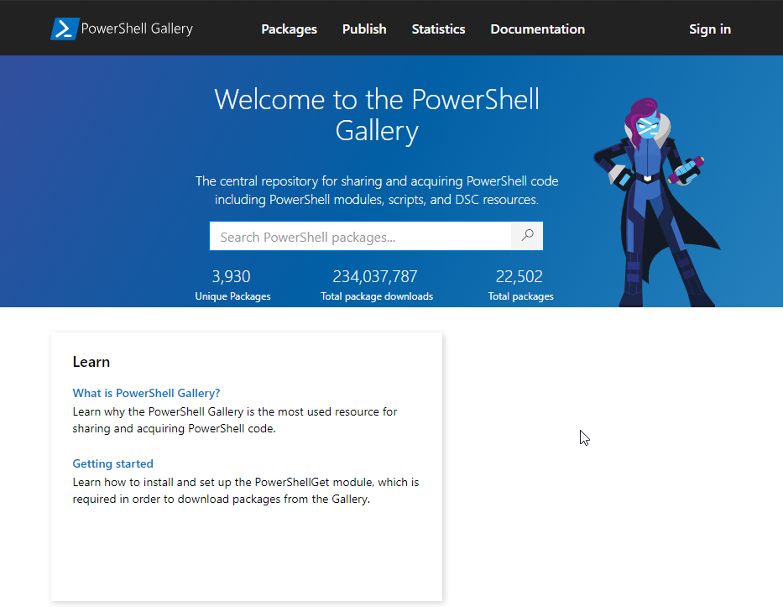
New Look and Features for PowerShell Gallery

Slide 7
Windows PowerShell 2.0 Deprecation
No timeline for removal but it will be removed in a future release
Why? To standardise on .Net 4.6+ and PowerShell Core

Slide 8
Universal Dashboard 2.0.0
Community Edition “Install-Module UniversalDashboard.Community”
Enterprise Edition “Install-Module UniversalDashboard”
Tree View
Floating Action Button
More Customizable Toasts
Azure Active Directory Authentication (Enterprise Only)

Slide 9
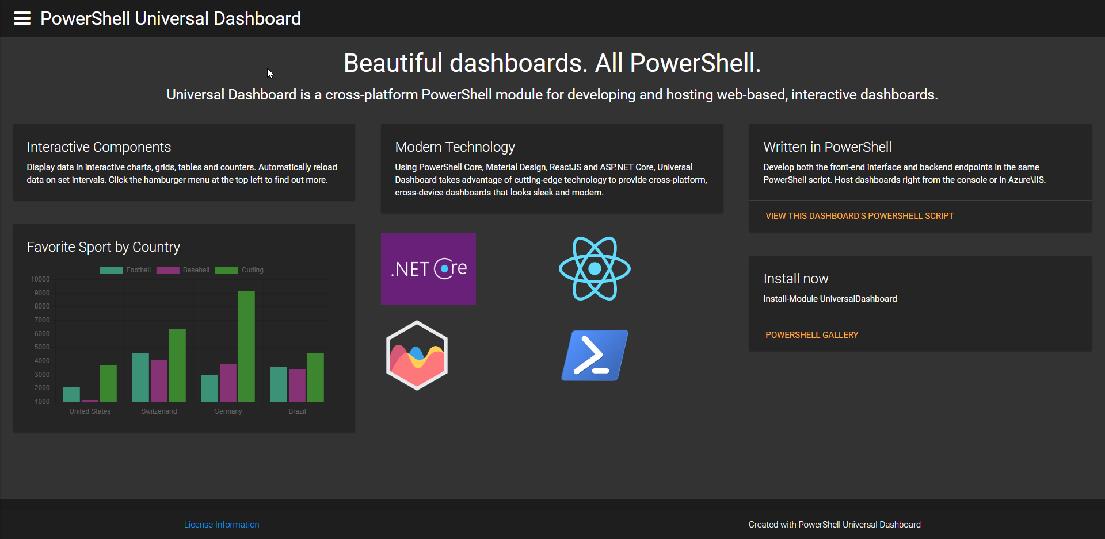
Universal Dashboard 2.0.0

Slide 10
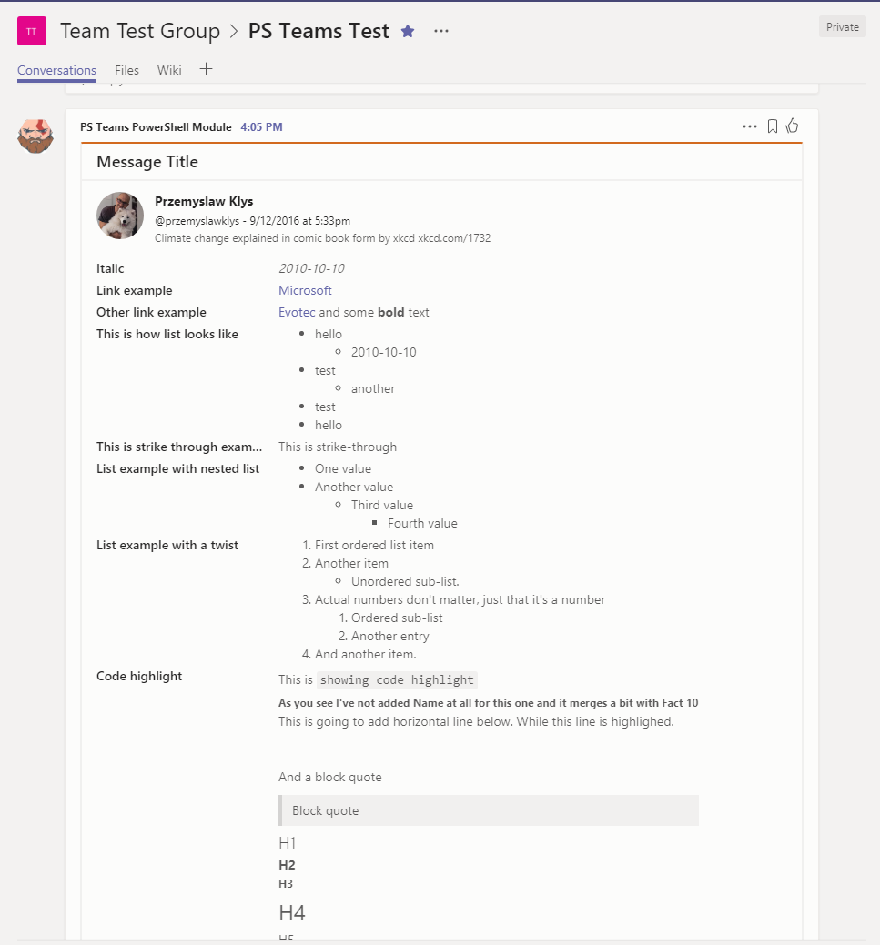
Module of the Month: PSTeams
Send feature rich notifications to Microsoft Teams
No license needed. Free to use.
Uses Webhooks
Install-Module PSTeams

Slide 11
Tips and Tricks
Fast, Efficient, Readable PowerShell

Slide 12
What’s on the menu?
• Working with Collections
• Working with Classes
• Iterating and Filtering
Aliases

Slide 13

Working with Collections
What are my options?
How can I improve performance?

Slide 14
Demo

Slide 15

Recommendations
Use lists
Use .Add()

Slide 16
Classes
How can I use Classes?
Why should I use Classes?

Slide 17
Demo

Slide 18
Suggestions
Use Classes
Use PSObject too

Slide 19
Where and Foreach
Where, Foreach, Where-Object, Foreach-Object

Slide 20
Demo

Slide 21
Suggestions
.Where is faster
.Foreach is faster
.Where uses more memory
.Foreach also uses more memory
Where-Object is easy to read

Slide 22
Aliases vs Full Syntax
Should I use Aliases?

Slide 23
Demo

Slide 24
Suggestions
Avoid aliases

Slide 25
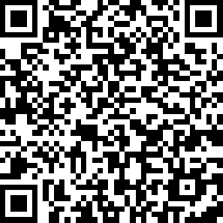
Session Feedback
https://www.surveymonkey.com/r/BRF6S6V

